Slide 1

Slide Show Presentation Completed by: Maureen Stolberg
Economic Forecasting Analysis
Predicting U.S. Consumption

Slide 2
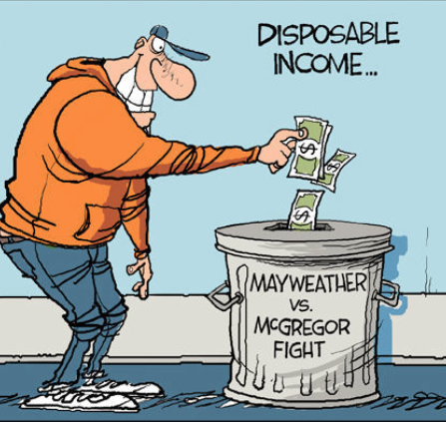
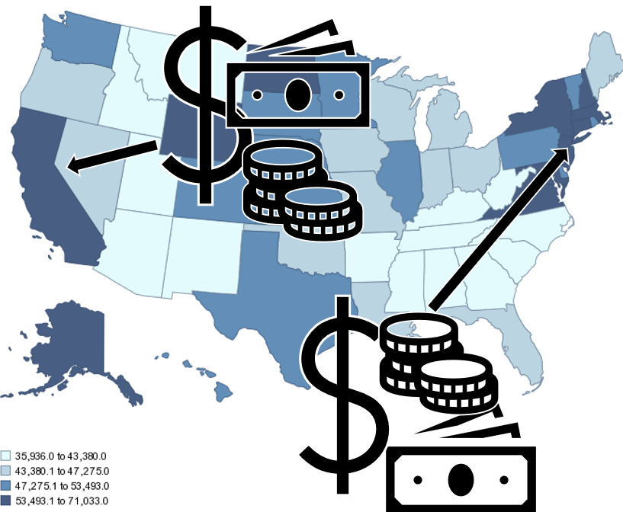


Determinants of Consumer Spending:
What is Consumer Spending?
“Consumer spending is the total money spent on final goods and services by individuals and households for personal use and enjoyment in an economy.”
-Investopedia
Disposable Income
Personal Income Per Capita
Consumer Debt
Consumer Confidence Index

Slide 3
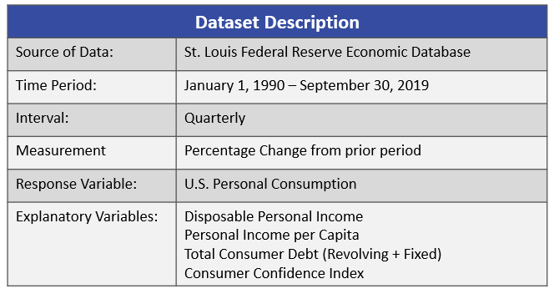
Why do we care about Consumer Spending?
Drives GDP
Determines Economic Health
Captures Current Economic Trend
Economic IMPACT
How is Consumer Spending Measured?
Consumer spending is measured several different ways.
The most comprehensive is the U.S. Personal Consumption Expenditures Survey.

Slide 4
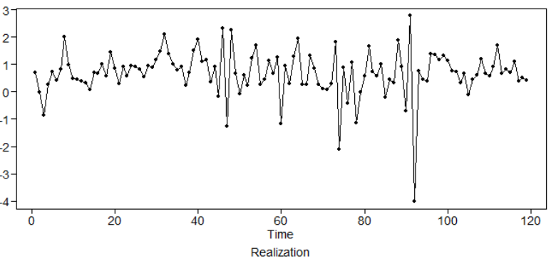
The Problem.
Economic forecasting is complicated
In Q1 2013, personal disposable income in the U.S. economy decreased by 4.0% compared to prior period.
Traditional ARIMA Models, forecasted with 95% confidence that personal disposable income would change with a magnitude of -1.4% to 2.1% with a best estimate of 0.37%.
Quarterly Changes in Disposable Income
(January 1991 – September 30, 2019)
-4.0%

Slide 5
The Problem.
Macroeconomic time series contain nonlinearities.
Small changes in a few variables make predictions almost impossibly complex.
There are several traditional linear forecasting techniques, such as AR, MA, ARIMA, and multivariate VAR have been used to effectively forecast economic time series.
These traditional methods have been reasonable successful in precision and accuracy, despite the limitations that occur when nonlinearities are present in the data.
Newer techniques, such as deep learning neural networks have been developed to forecast time series data and are being used as nonlinear forecast models
As the world gets more complicated, macroeconomic relationships will become more complex and the presence of data linearities will rise.
How will the increase in data nonlinearities impact economic forecasts?
Will the performance of traditional models be able to keep up with the new AI models?

Slide 6
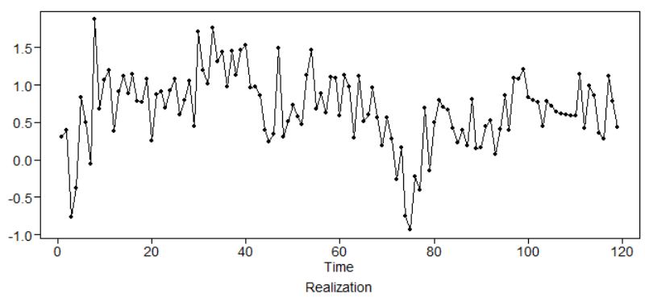
The Question of Interest.
The objective of this study is to compare the performance of traditional models vs. non-traditional models during periods where data nonlinearities are likely to be present.
Quarterly Changes in US Consumption
(January 1991 – September 30, 2019)
Key Economic decisions make by policymakers in 2017 increased the presence of data nonlinearities and created significant risks for the 2018 & 2019 economic forecasts.
As a result, many industry experts failed to accurately measure the impact of these risks and therefore consequently produced muted results.
This study will examine the ARIMA, VAR, and NNP models and compare forecasts over the same period in attempt to identify which model is more effective at picking up on the change in behavior.

Slide 7
Important Note.
Please note that in my previous video covered many of the basics, such as Stationarity vs. Non-Stationarity , the importance of differencing the data, and definition of US Consumption.
Due to restrictions on time, I will refrain from covering those topics and ask that if you are interested in learning more about the basics to please preview my last video before proceeding any further. Thanks!

Slide 8
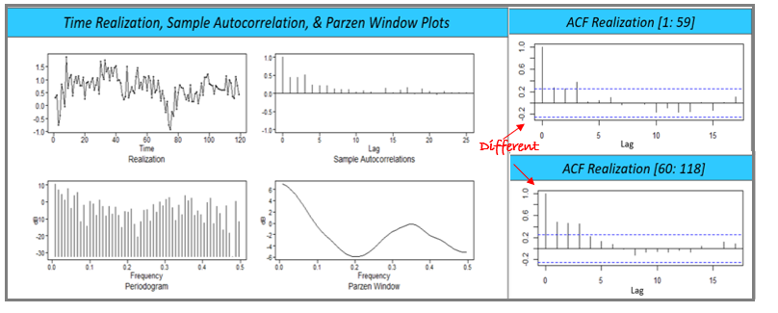
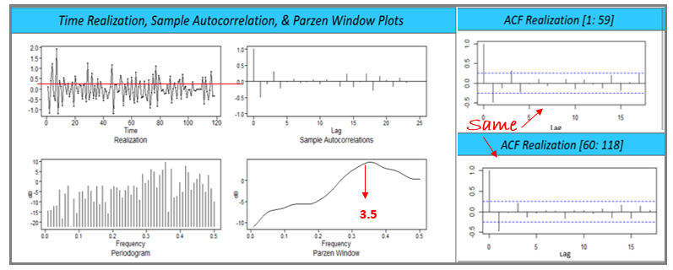
The Basics.
Time Series does not appear to be stationary.
Realizations shows wandering behavior with a slight hint of cyclic behavior.
Sample Autocorrelations shows dampening with a slight indication of sinusoidal cyclic behavior.
Pattern differences across ACF 1 and ACF 2 suggest autocorrelation issues.
Spectral density indicates two peaks, one at zero and a second at 3.5, suggesting the pseudo-mix of wandering and cyclic behavior.
0
Peak
3.5
Taking the difference of the data created stationarity across the time series.
Wandering behavior was removed. Realization and mean behavior appear constant.
Sample Autocorrelations now indicative of stationary white noise
Pattern differences across ACF 1 and ACF 2 no longer exist.
Spectral density indicates peaks at 3.5, suggesting the pseudo-mix of wandering and cyclic behavior.

Slide 9


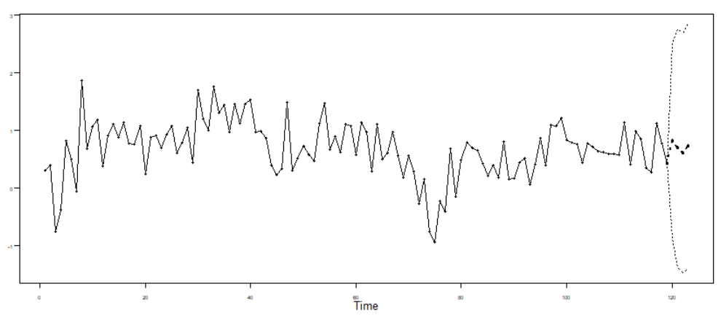
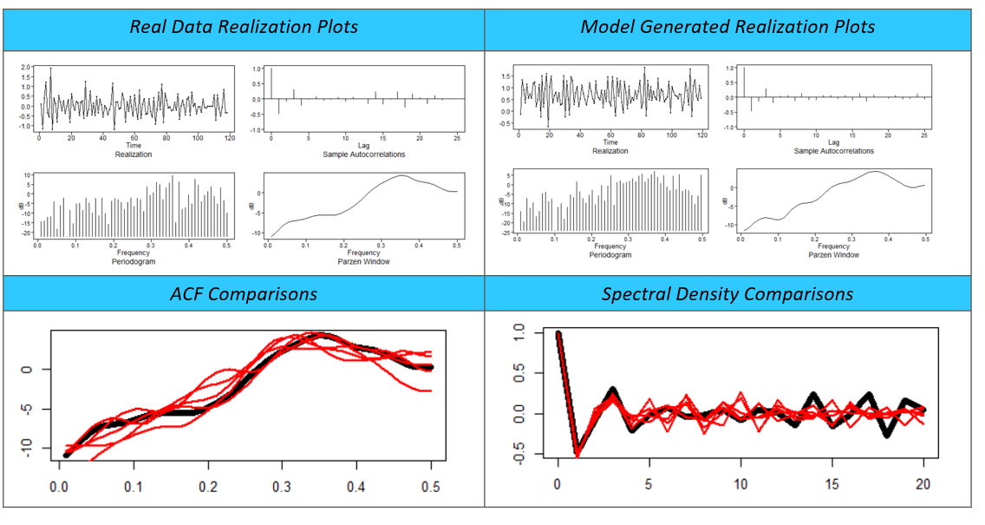
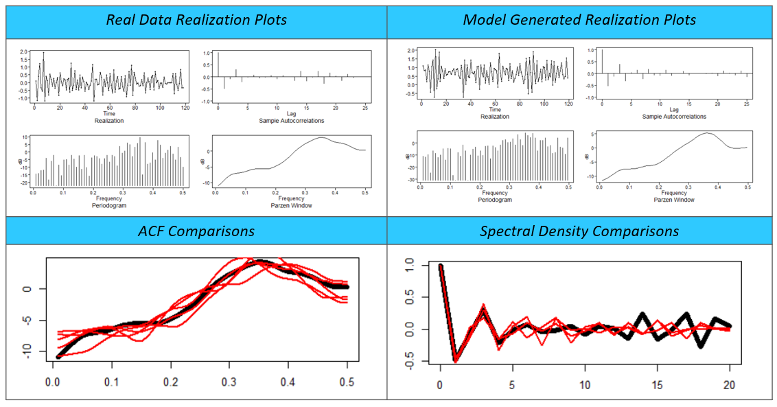
ASE SCORES
ARIMA 1 Model ARIMA 2 Model
0.14483 0.15764
ARIMA Models.
Model Forecast
Model Vs. Real Data Comparisons
Model Forecast
Model Vs. Real Data Comparisons
√ lowest AIC, BIC & ASE
VS

Slide 10
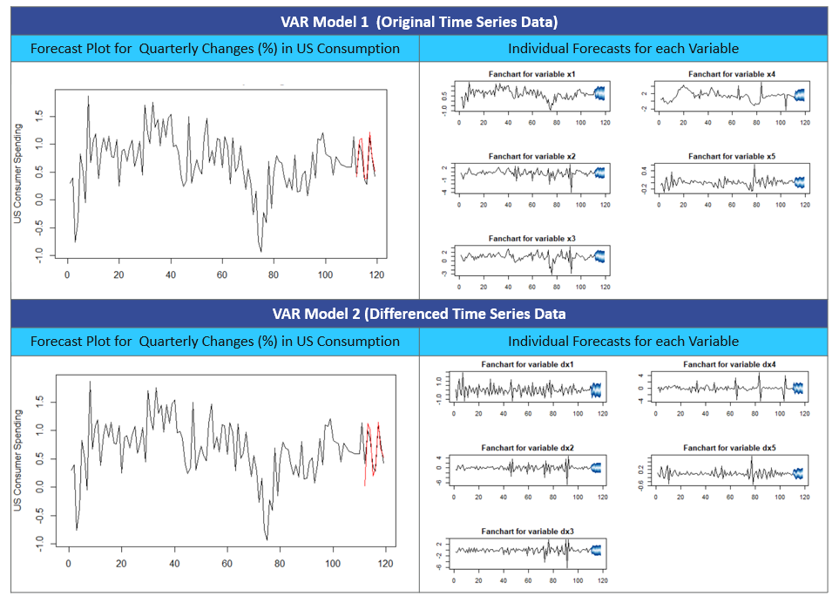
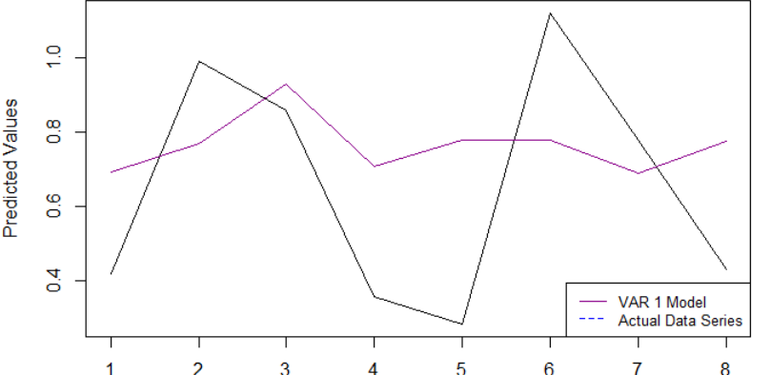
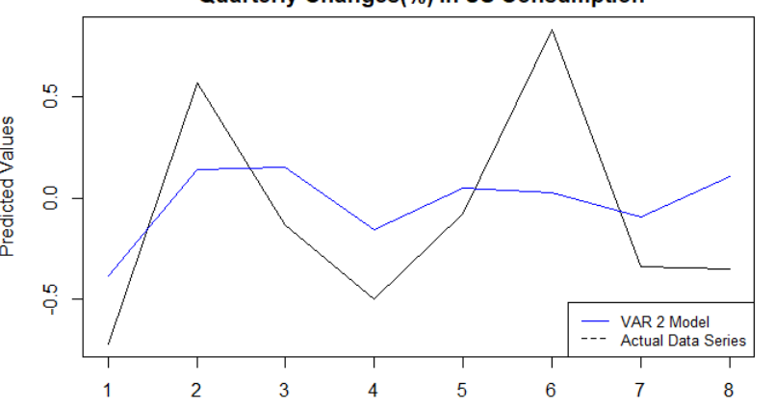
VAR Models.
ASE SCORES
Var 1 Model VAR 2 Model
0.0925 0.5307
Model Characteristics
Variables are treated as “endogenous”
Including multiple coefficients can lead to large models and therefore large estimation errors
Every variable is assumed to influence every other variable in the system which makes direct interpretation difficult
Model execution is relatively simple, making it popular among forecasters
Unique to This Forecast
Final model included 21 constituents; however, only 3 turned out to be significant.
Predicted vs. Actual data values highlights how the large number of insignificant constituents detract from performance by muting the significant behavior.
Final Model:
X.l= -0.733X.l1 + 0.148X2.l1 -0.073X3.l1 -0.069X4.l1 + 0.087X5.l1 -0.291X.l2 + 0.140739X2.l2 -0.089059X3.l2 -0.098X4.l2 + 0.122X5.l2 + 0.144X.l3 + 0.013X2.l3 + 0.029X3.l3 -0.088X4.l3 + 0.388X5.l3 + 0.006X.l4 -0.069X2.l4 + 0.052X3.l4 -0.075X4.l4 + 0.274X5.l4 + 0.013const

Slide 11
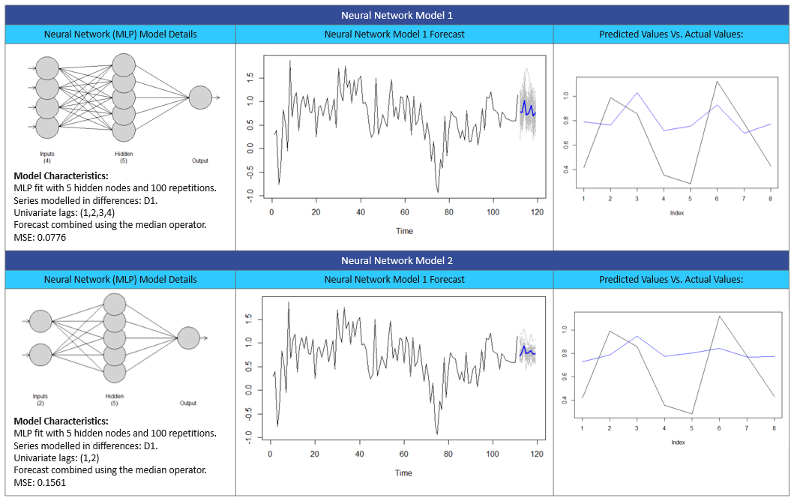
ASE SCORES
NN1 Model NN2 Model
0.0918 0.0979
Univariate Neural Network Models.
Model Definition:
Neural Network Model 1: Basic MLP Model. Allowed program to set the parameters
Neural Network Model 2: Model includes at least one order of difference in order to allow for apples to apples comparison on the ARIMA model.
Model Characteristics:
Can pick up relationships that parametric models may miss
No Stationary Assumption
Capable of producing nonlinear models without prior beliefs about the functional forms.
Unique to this Forecast:
The first model did a good job with identifying the size and impact of each behavior change.
The second model has a low ASE score but performance from a behavior standpoint looks to be similar to what we have seen in the ARIMA and VAR models.

Slide 12
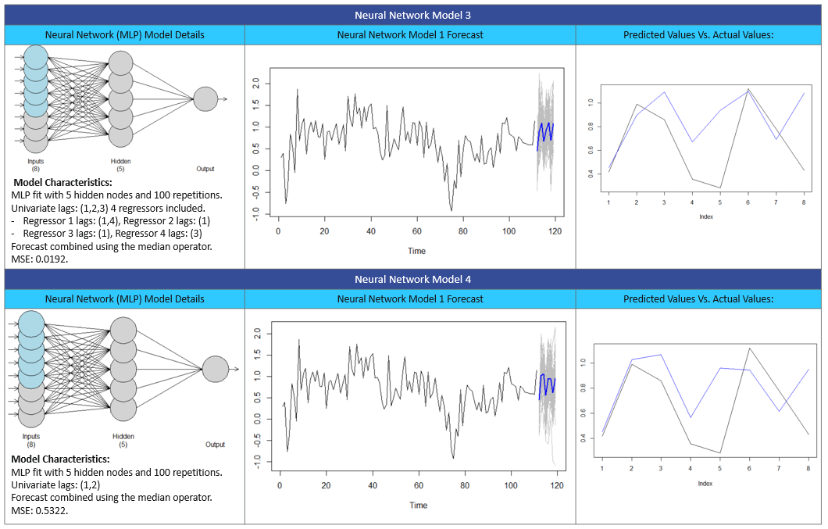
ASE SCORES
NN3 Model NN4 Model
0.1281 0.1315
Multivariate Neural Network Models.
Model Characteristics:
Can pick up relationships that parametric models may miss
No Stationary Assumption
Capable of producing nonlinear models without prior beliefs about the functional forms.
Model Definition:
Neural Network Model 3: Assumes that the regressors are known ahead of time.
Neural Network Model 4: Assumes that regressors are unknown-Individual regressor forecasts are used as inputs to the final model forecast.
Unique to this Forecast:
Both models did a good job with identifying the size and impact of each behavior change.
The last data point in forecast conflicting directional movement- something to be cautious about

Slide 13
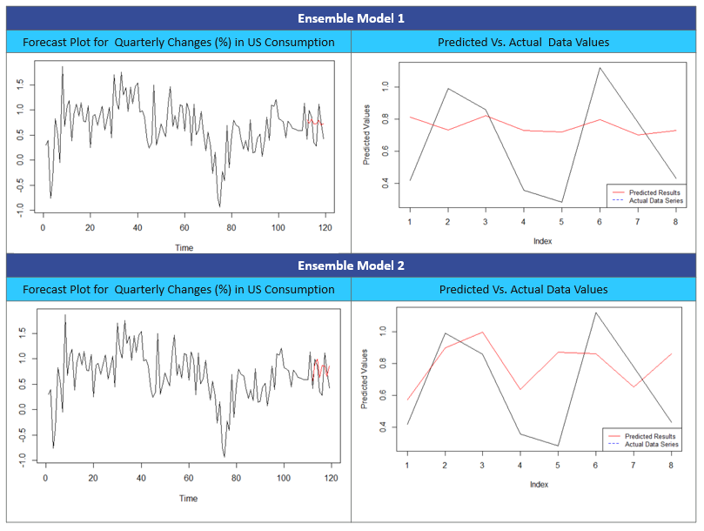
ASE SCORES
Ensemble 1 Ensemble 2
0.0938 0.1036
Ensemble Models.
Model Definition:
Ensemble 1 Model: (Univariate Forecast)
Comprised of ARIMIA (2,1,0) and the basic neural network model NN1.
Ensemble 2 Model: (Multivariate Forecast)
Comprised of VAR 1 Model and the multivariate neural network with estimated regressor variables.
Model Characteristics:
Seeks to optimize forecasting results by offsetting risk through increased diversification.
Models selected for inclusion are independent and diverse from one another.
Unique to this Forecast:
Ensemble 1 Model shows muted behavior. Mostly driven by the ARIMA component and it’s limitation with processing data nonlinearities
Ensemble 2 Model appears to capture the behavior well. However, forecast estimation error would be large due to the large number of constituents included in both models.

Slide 14
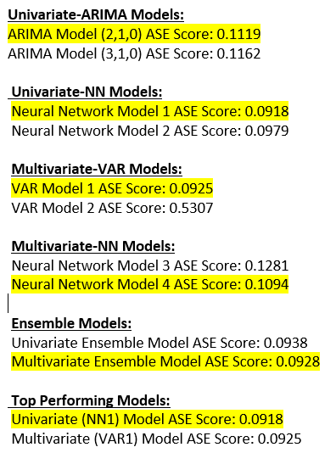
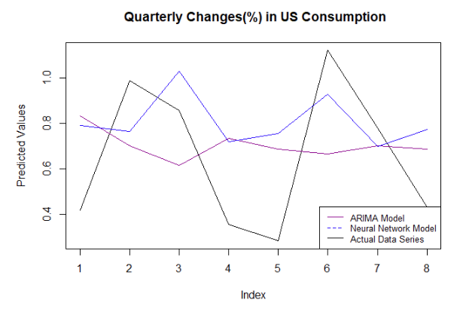
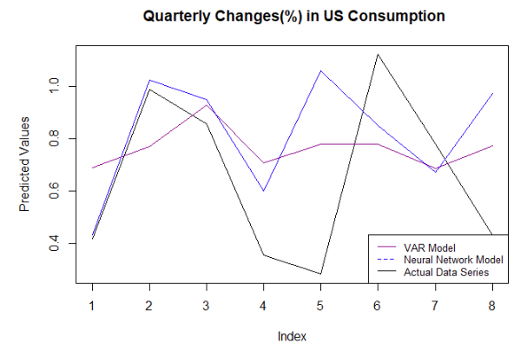
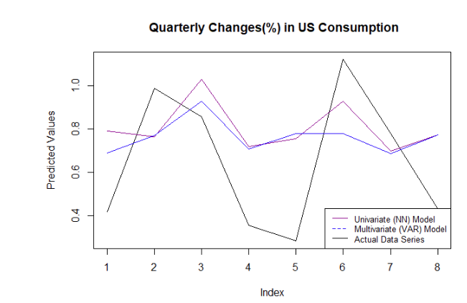
Model Comparisons.

Slide 15
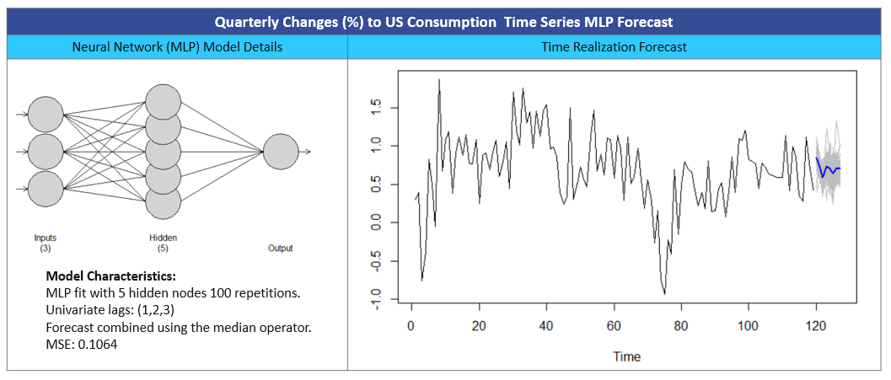
Final Model 2 Year Predictions .
Over the next 8 quarters, we are 95% confident that the quarterly change in US consumption will be between 0.4967% and 0.9180%. Our best quarterly estimate is 0.6877%.

Slide 16

Additional Research References.
To learn more on how the presence of neural network models is impacting the world of economic, please find some additional references below.
Video Lectures:
Modeling Multivariate Time Series in Economics
Harvard CMSA
Lecture 10| Recurrent Neural Networks
Stanford University
Time Series Forecasting Using Recurrent Network and Vector Autoregressive Model: When and How
(presented by Alliance Bernstein Chief Information Officer)
Databricks Platform

Slide 17
Thank you for Listening!!
Next Steps: Future Analysis
Model Types that will be examined:
Univariate Analysis
ARUMA (Quarterly) Seasonal Analysis
Signal Plus Noise Model
Multivariate Analysis
VAR Analysis
Neural Network
Esemble Models

